Slide 1
Statistical Thinking for Machine Learning – Part 4

Slide 2
Agenda
Variable Transformations – Interpreting Results
Affine
Polynomial
Logarithmic
Dummy Variables
Interactions
Logistic Regression
Why use logistic regression?
Forming the Logistic Regression
The Link Function
Interpreting Coefficients
Determining the effect size

Slide 3
Types of Variables and Transformations
Transforming variables and/or including different types of variables can improve model performance
Let’s look at different options:

Slide 4
Affine
Affine transformations are transformations that don’t effect the fit of the model. The most common example is scaling transformations.
Example:
Weight (lbs) = 5 + 2.4*Height(inches)
Weight (lbs) = 5 + 0.094*Height(mm)
This is why scaling variables is not necessary for linear regression but knowing the scale of your variables is VERY necessary.

Slide 5

Polynomial
Linear regression can still be used to fit data with a non-linear distribution
The model is linear in parameters, not necessarily variables
I.e. we must have B1, B2, B3, but we can utilize X1² or X2/X3
We might leverage the above to generate a curved regression line, providing a better fit in some cases
How do we now interpret the coefficients
The big difference is the effect of an increase in experience on wage now depends on the level of experience

Slide 6
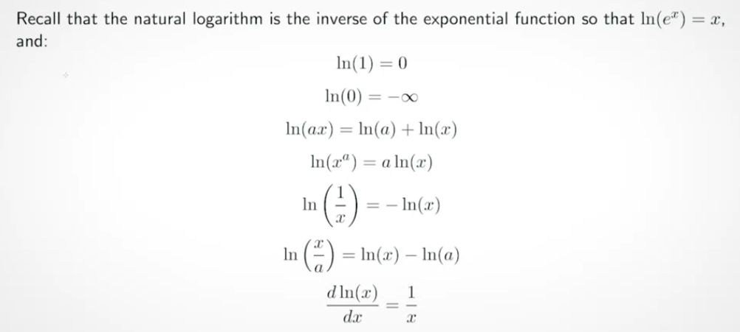
Logarithmic

Slide 7
Interpreting Log Variables
B0 = 5, B1 = .1, X=10
Level-Log: Y = 5+.1*ln(X)
1% change in X = .01*B1 change in Y
Log-Level: ln(Y) = 5+.1*X
One unit change X = 100*B1% change in Y
Log-Log: ln(Y) = 5+.1*ln(X)
1% change in X = B1% change in Y

Slide 8
Dummy Variables
Categorical or “dummy” variables help us represent groups or place continuous variables into bins
What is this regression telling us:
NBA_salary = 5*PPG + 10.5*Guard +9.6*Forward + 10.8*Center
Do we need dummy variables for Guard, Forward, and Center?
How would the regression change if we only used 2 out of 3?
NBA_salary = 10.5 + 5*PPG – 0.9*Forward + 0.3*Center
10.8 + 5*PPG -0.3*Guard – 1.2*Forward – same F stat
Dummy variables or “One-hot encoding” is how categorical variables can be mathematically represented

Slide 9
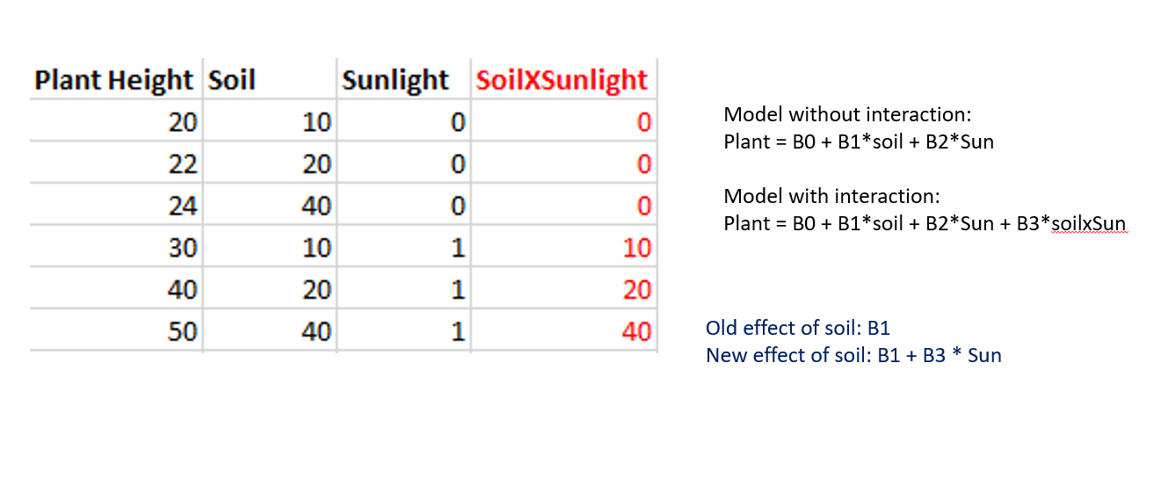
Interaction Terms
What if we want to estimate the effect of a variable, but that variable has a different effect depending on another variable? Answer: Interaction Terms

Slide 10
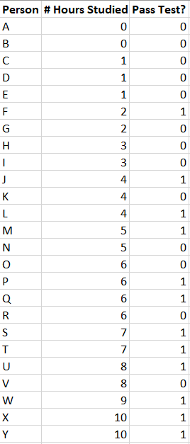
Why Logistic Regression?
Why don’t we just use linear regression?
Pass Test = B0 + B1*# Hours Studied

Slide 11
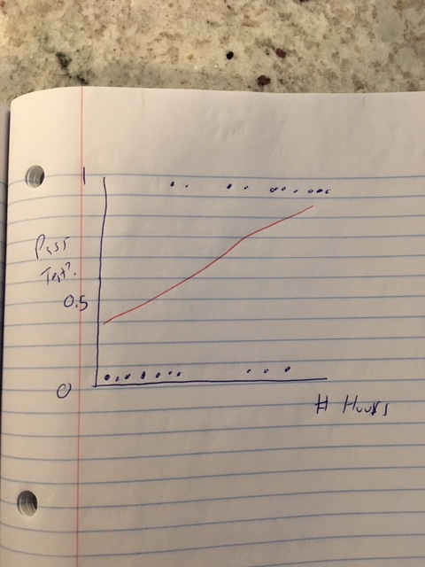
If we used Linear Regression…
Pass Test = .4 + 0.1*# Hours Studied

Slide 12
Reason to use Logistic Regression
Model cannot output values outside of a 0,1 range
Each incremental unit does not necessarily count the same
We do not want heteroskedastic errors

Slide 13
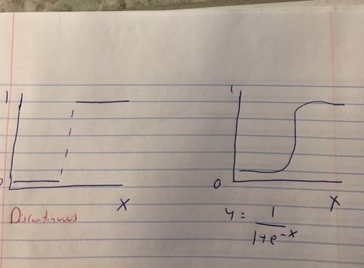

Logistic Regression
Logistic is a linear classifier
We’ll need a smooth function that is not discontinuous and only produces values between 0,1
We’ll use the standard logistic sigmoid function: $y=1/(1+e^{−x})$

Slide 14
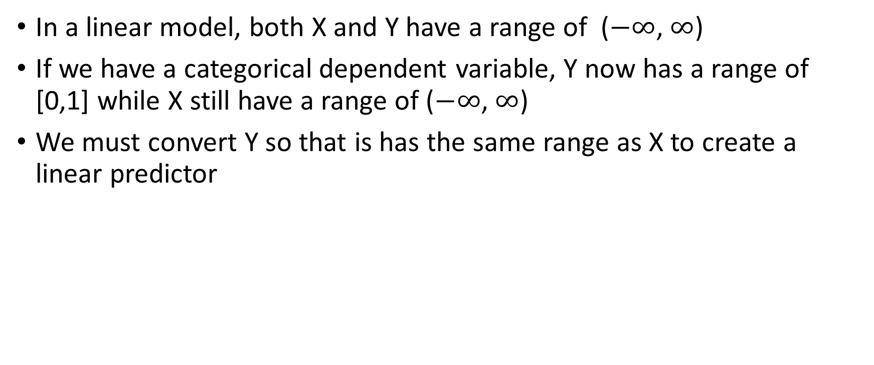
Forming the Logistic Regression Model
In a linear model, both X and Y have a range of ($−∞$, $∞$)
If we have a categorical dependent variable, Y now has a range of [0,1] while X still have a range of ($−∞$, $∞$)
We must convert Y so that is has the same range as X to create a linear predictor

Slide 15
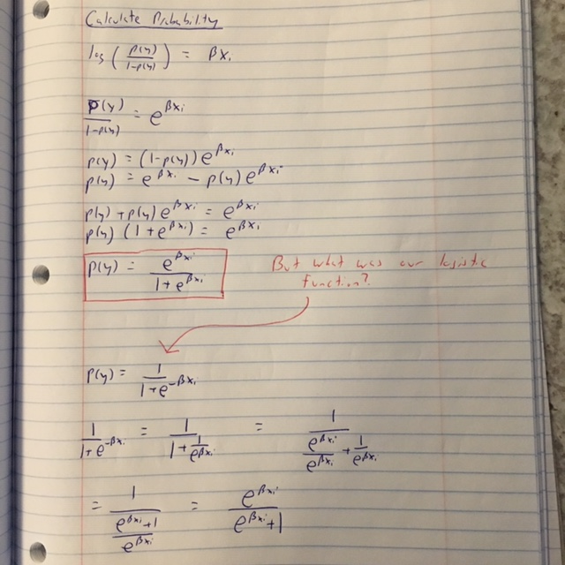
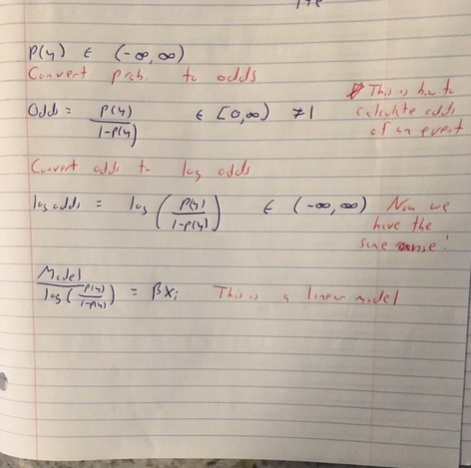
*Error top line, p(y) range is [0,1]

Slide 16
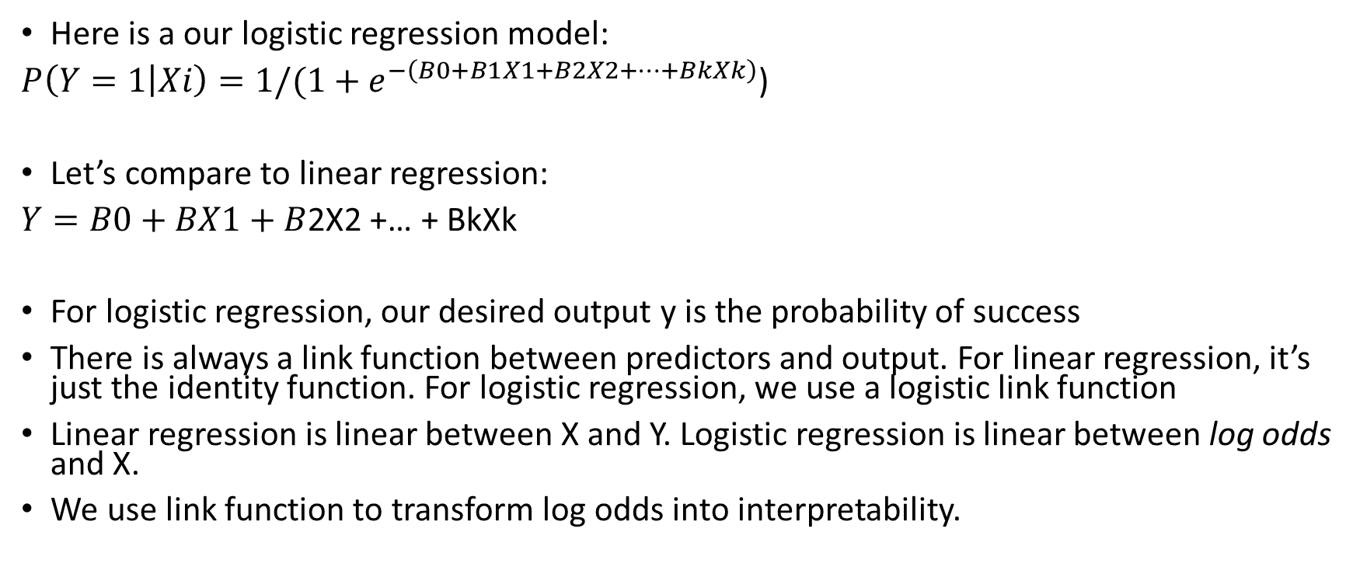
Link Function
Here is a our logistic regression model:
$P\left(Y=1 | Xi\right)=1/(1+e^{−\left(B0+B1X1+B2X2+…+BkXk\right)}$)
Let’s compare to linear regression:
$Y=B0+BX1+B$2X2 +… + BkXk
For logistic regression, our desired output y is the probability of success
There is always a link function between predictors and output. For linear regression, it’s just the identity function. For logistic regression, we use a logistic link function
Linear regression is linear between X and Y. Logistic regression is linear between log odds and X.
We use link function to transform log odds into interpretability.

Slide 17
Estimation of Coefficients
We will not use sum of squares to evaluate accuracy of this model, since this function is subject to multiple local minimums
Instead, we’ll use logistic loss function:
$$y∗\log\left(p\right)+\left(1−y\right)∗\log\left(1−p\right)$$
Betas will be estimated using maximum likelihood estimation
Maximum likelihood: Given a sample, what is the parameter with the highest probability of observing or what is the parameter with the maximum likelihood of being correct?

Slide 18
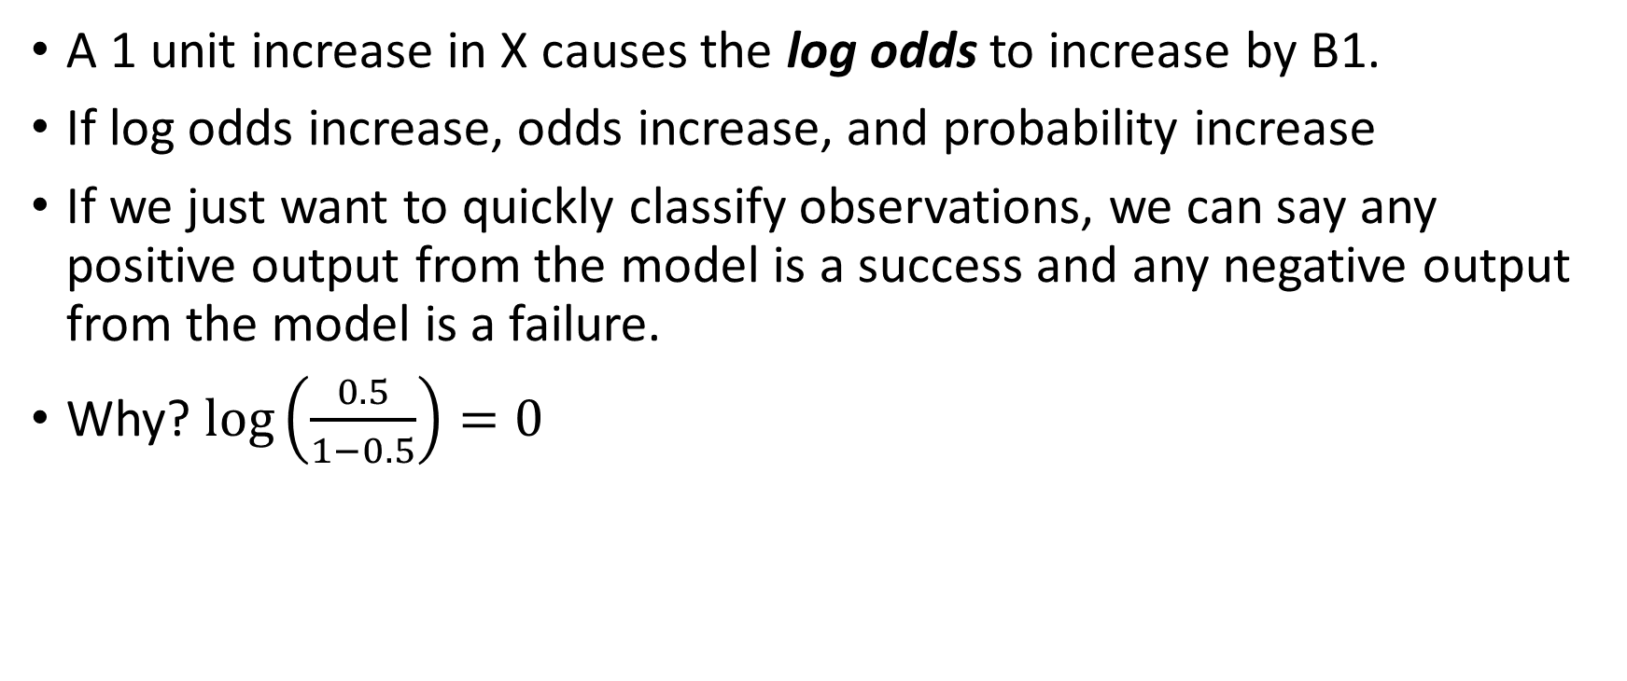
Interpretation of Coefficients and Output
A 1 unit increase in X causes the log odds to increase by B1.
If log odds increase, odds increase, and probability increase
If we just want to quickly classify observations, we can say any positive output from the model is a success and any negative output from the model is a failure.
Why? $\log\left(\frac{0.5}{1−0.5}\right)=0$

Slide 19
An alternative link -- Probit
Inverse CDF of normal distribution of probability = B0 + B1X1…
Link function is normal CDF

